Slide 1
Code Injection
--Sri Harsha, CyberEye.

Slide 2
Code Injection : Main idea
Here we are using “sprintf” to copy the string into buffer
There are two main challenges for code injection:
Load my code into memory.
Getting the instruction pointer to point to it, so that code can be executed.
Void func(char *arg1)
{
Char buffer[4];
sprintf(buffer, arg1);
…
}

Slide 3
Challenge 1
Loading code into memory
It must be the machine code instructions (i.e., already compiled and ready to run)
We have to be careful in how to construct it.
It can’t contain any all-zero bytes
Otherwise sprintf/gets/scanf/strcpy… will stop copying, if the code contains zeros.
It can’t use the loader (we’re injecting)

Slide 4
What code to run?
Goal : general-purpose shell.
Command-line prompt that gives attacker general access to the system.
The code to launch a shell is called shellcode.
Let’s have a look at the Shellcode….

Slide 5
Shellcode
It’s a simple function that calls “execve”, which effectively transforms the current program into the one given as an argument
#include<stdio.h>
Int main( ) {
Char *name[2];
name[0] = “/bin/sh”;
name[1] = NULL;
execve( name[0], name, NULL);
}

Slide 6
Challenge 2
Getting the injected code to run
We can’t insert a “jump into my code” instruction.
We don’t know precisely where our code is with respect to the instruction pointer.
Somehow, we have to get it at the start and start running.
If we remember the memory layout, the very last step jumps back to the location of the return address ( in returning functions) which was saved on the stack.

Slide 7
Therefore, we can store the address of our code at that location and get the program to jump to that code.

Slide 8
Challenge 3
Finding the return address
If we don’t have access to the code, we don’t know how far the buffer is saved %ebp
One approach: just try a lot of different values!
Worst case scenario: it’s a 32 ( or 64 ) bit memory space, which means 2^32 ( 2^64 ) possible answers.
Without address randomization
The stack always starts from the same fixed address.
The stack will grow, but usually it doesn’t grow very deeply ( unless the code is heavily recursive). This reduces the search base dramatically

Slide 9
Improving our chances: nop sleds
A nop is a single - byte instruction that just moves to the next instruction.
If the adversary sticks a bunch of nops as padding, prior to his own code then jumping anywhere in that nop sled will work.
Now we can improve our chances of guessing by a factor of #nops.

Slide 10







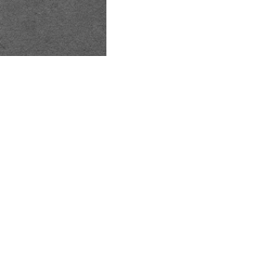
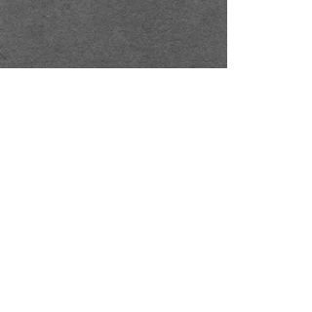



Putting
all
together
it
But it has to be something;
we have to start writing wherever the input to gets/etc., begins
.
padding
good
guess
^{%eip}
Text
...
⁰⁰ ⁰⁰ ⁰⁰ ⁰⁰ %ebp
0xbdf
nop nop nop …
0f \x3c \x2f ...
%eip
0xbff
…
&arg1
\x
buffer
^{nop sled}
malicious code

Slide 11
Other Attacks
The code injection attack we have just considered is called stack smashing.
The term was coined by Aleph One in 1996.
Constitutes an integrity violation, and arguably a violation of availability.
The attack has corrupted the important data in the program and enabled further corruption of data on the system by allowing arbitrary code to run on behalf of attacker.
Other attacks exploit bugs with buffers, too
Another sort of attack is a heap overflow attack.

Slide 12
Heap overflow
Stack smashing overflows a stack allocated buffer.
You can also overflow a buffer allocated by malloc, which resides on the heap.
The following code gives an example:
At the top we define a struct, vulnerable_struct, that has two fields, one is buff, a character pointer, the second is the compare function pointer.
The function foo takes vulnerable struct as an argument along with two character pointers
must have strlen (one) + strlen (two) < MAX_LEN or we overwrite s->cmp.
typedef struct _vulnerable_struct{
char buff[MAX_LEN];
Int (*cmp) (char* , char*);
} vulnerable;
int foo ( vulnerable* B, char *one, char *two)
{
strcpy ( s->buff, one);
strcat ( s->buff, two);
return s->cmp ( s->buff, “file://foobar”);
}

Slide 13
Heap overflow variants:
Overflow into c++ object vtable.
C++ objects are represented using a vtable, which contains pointers to the object’s methods.
This table is analogous to s->cmp in above example and same kind of attack will work.
Overflow into adjacent objects.
Where buff is not collocated with a function pointer, but is allocated near one on the heap.
Overflow heap metadata.
Hidden header just before the pointer returned by malloc.
Flow into header to corrupt heap itself.

Slide 14
Integer overflow
These attacks rely on the fact that in C, a variable has a maximum value, and when that value is exceeded the variable’s value will wrap around.
In this case we are reading in from the network using packet_get_int function.
If we set nresp to 1073741824 and sizeof ( char* ) is 4.
then nresp*sizeof ( char* ) overflows to become 0.
Subsequent writes to allocated response overflow it.
void vulnerable( )
{
char *response;
int nresp = packet_get_int ( );
If ( nresp > 0 ) {
response = malloc ( nresp*sizeof( char* ));
for ( i=0; i<nresp; i++)
response[1] = packet_get_string (NULL);}
}

Slide 15
Corrupting data
The attacks we have seen so far affects code.
Return addresses and function pointers.
But attackers can overflow data as well, to
Modify a secret key to be one known to the attacker, to be able to decrypt future intercepted messages.
Modify state variables to bypass authorization checks.( in the previous example we used authenticated flag).
Modify interpreted strings used as part of commands.

Slide 16
Read overflow:
Rather than permitting writing past the end of a buffer, a bug could permit reading past the end
Might leak the secret information
int main ( ) {
char buf[100], *p;
int i, len;
while (1) {
p= fgets(buf, sizeof(buf), stdin);
if (p==NULL) return 0;
len = atoi(p);
p= fgets(buf, sizeof(buf), stdin);
if (p==NULL) return 0;
for (i=0; i<len; i++)
if (liscntrl(buf[i])) putchar (buf[i]);
else putchar (‘.’);
printf(“\n”);}}

